Slide 1

Welcome, Take a seat and start the Downloads
Because I don't trust the WiFi
SSID: OrdinaNLGuest Password: Aheadofchange!
What you need (for today):
VSCode
Extensions: Dart, Flutter
Flutter SDK
https://docs.flutter.dev/get-started/install
Just start the download, follow the rest of the guide later.

Slide 2

Flutter
Fast multi-platform apps
With just 1 codebase

Slide 3
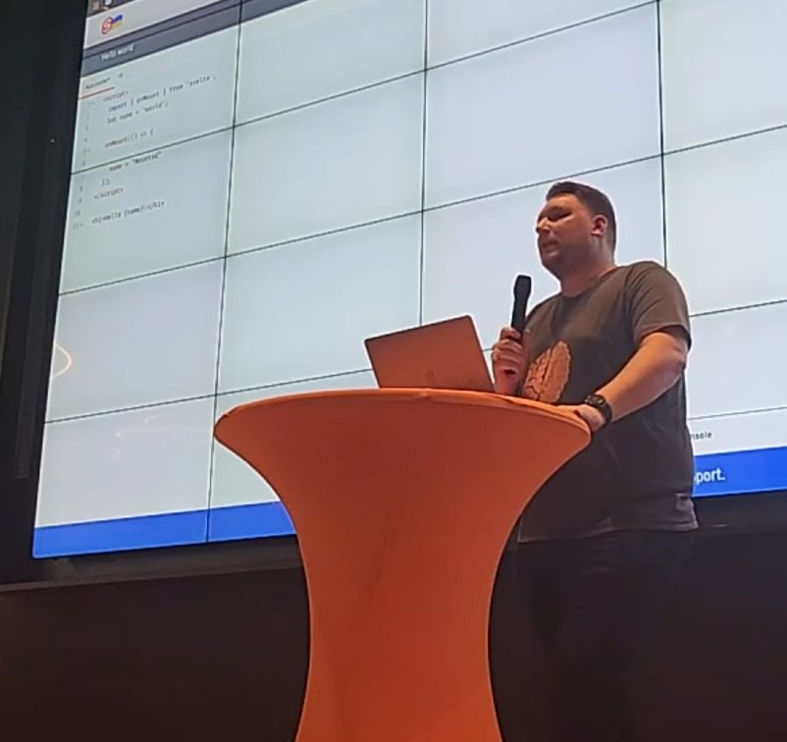
Robbin Schepers
Professional Computer Nerd
Find me online: @Roboroads
Notes:
Proffessional Computer nerd, 50 hrs, Ordina and freelance, CZ app, PHP/Laravel en Svelte.

Slide 4


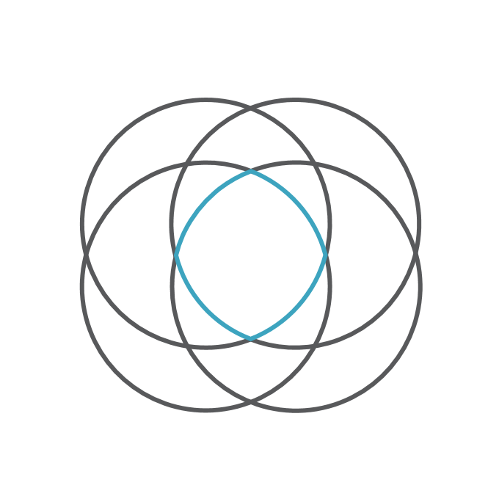

What is Flutter
UI Framework
Written in Dart
Open Source
Made by Google

Slide 5




Why use Flutter
All Platforms – One Codebase
Mobile: Android & iOS Desktop: Windows, MacOS & Linux Web: All browsers (except IE6)
Easy to Understand
Flutter Engine
Look & Feel with Material and Cupertino
Native Performance
120hz on supported devices.

Slide 6
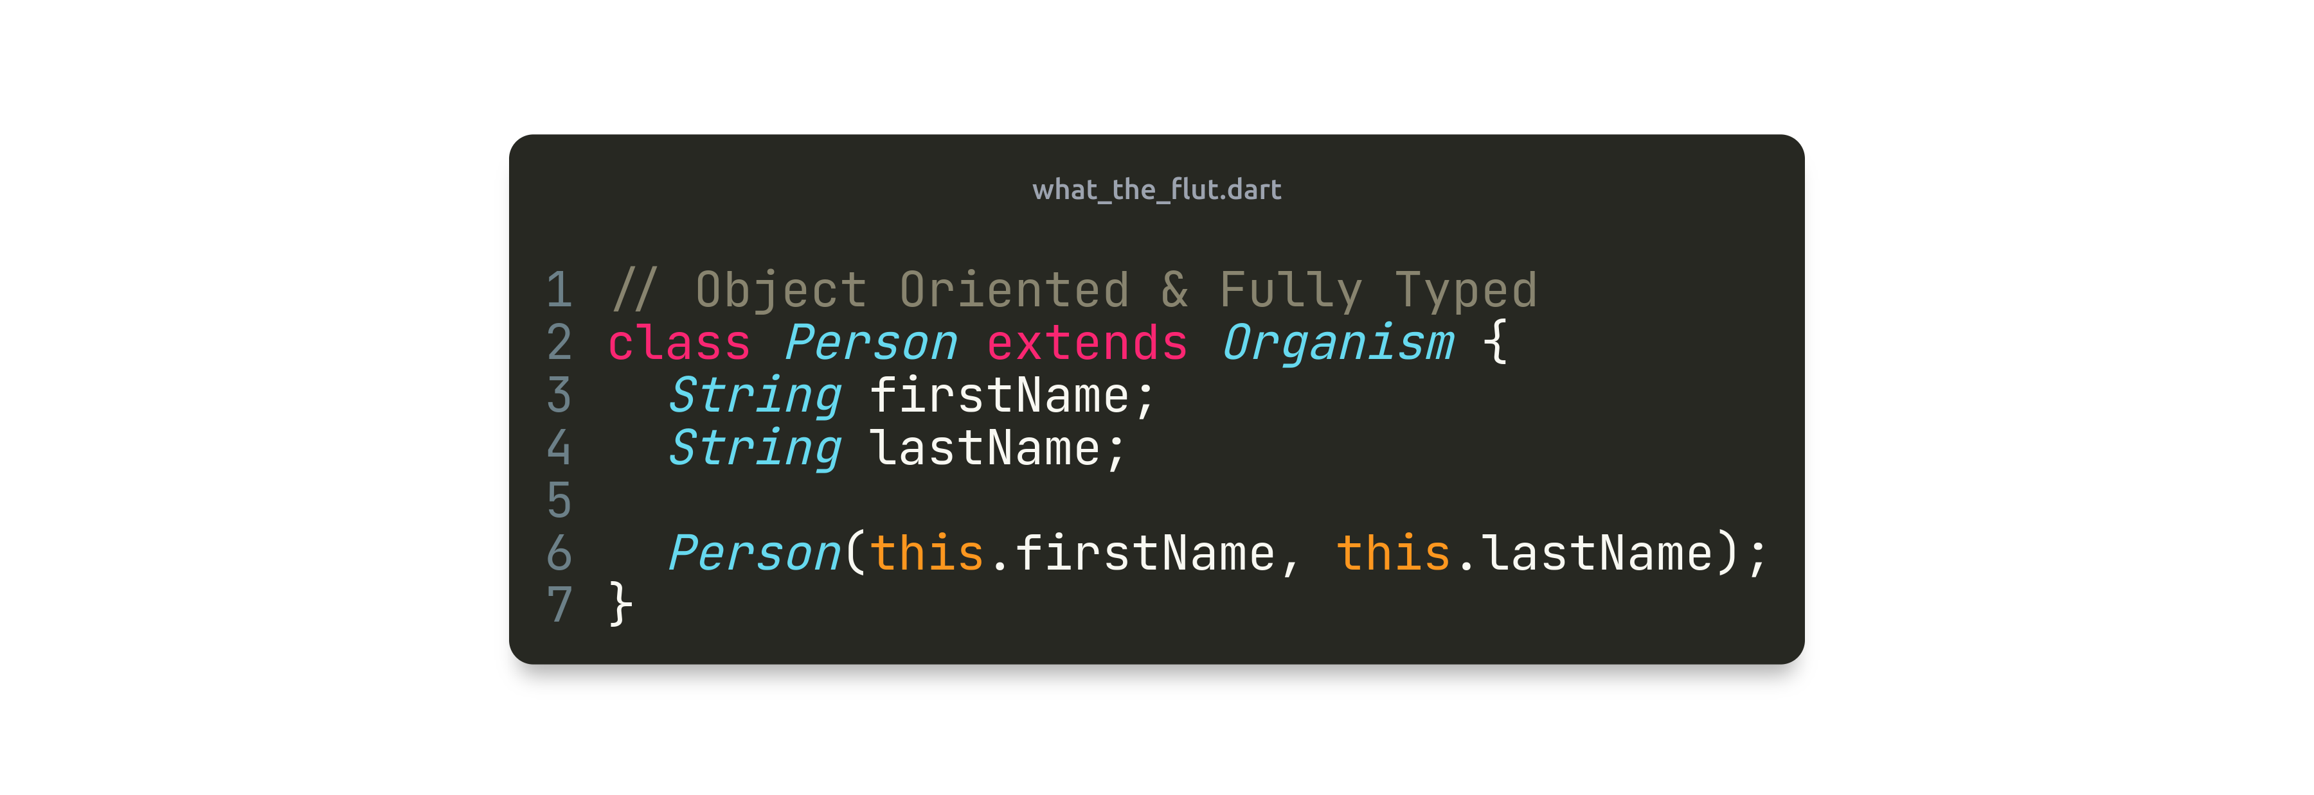
Key concepts of the Dart syntax

Slide 7
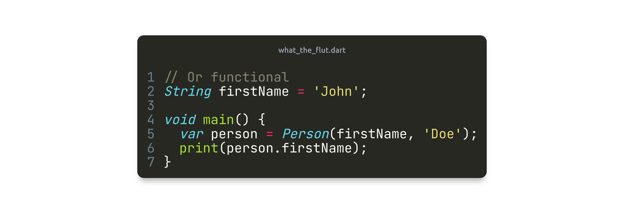
Key concepts of the Dart syntax

Slide 8
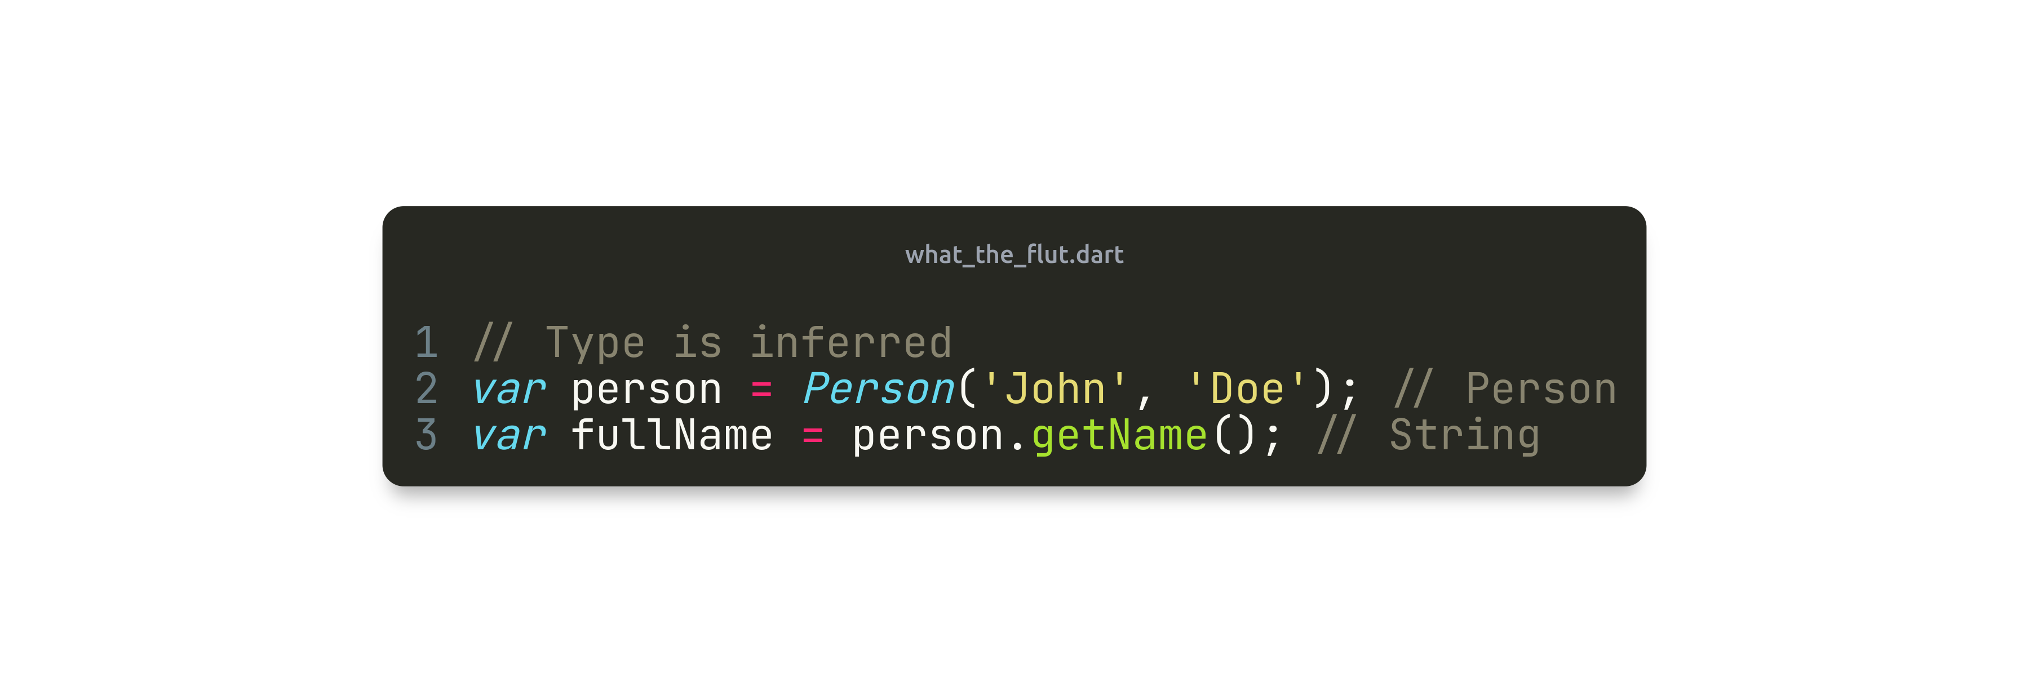
Key concepts of the Dart syntax

Slide 9
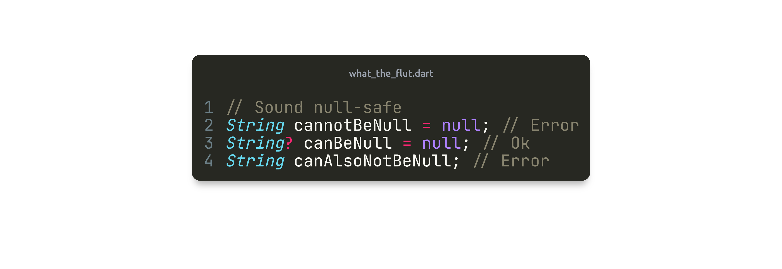
Key concepts of the Dart syntax

Slide 10
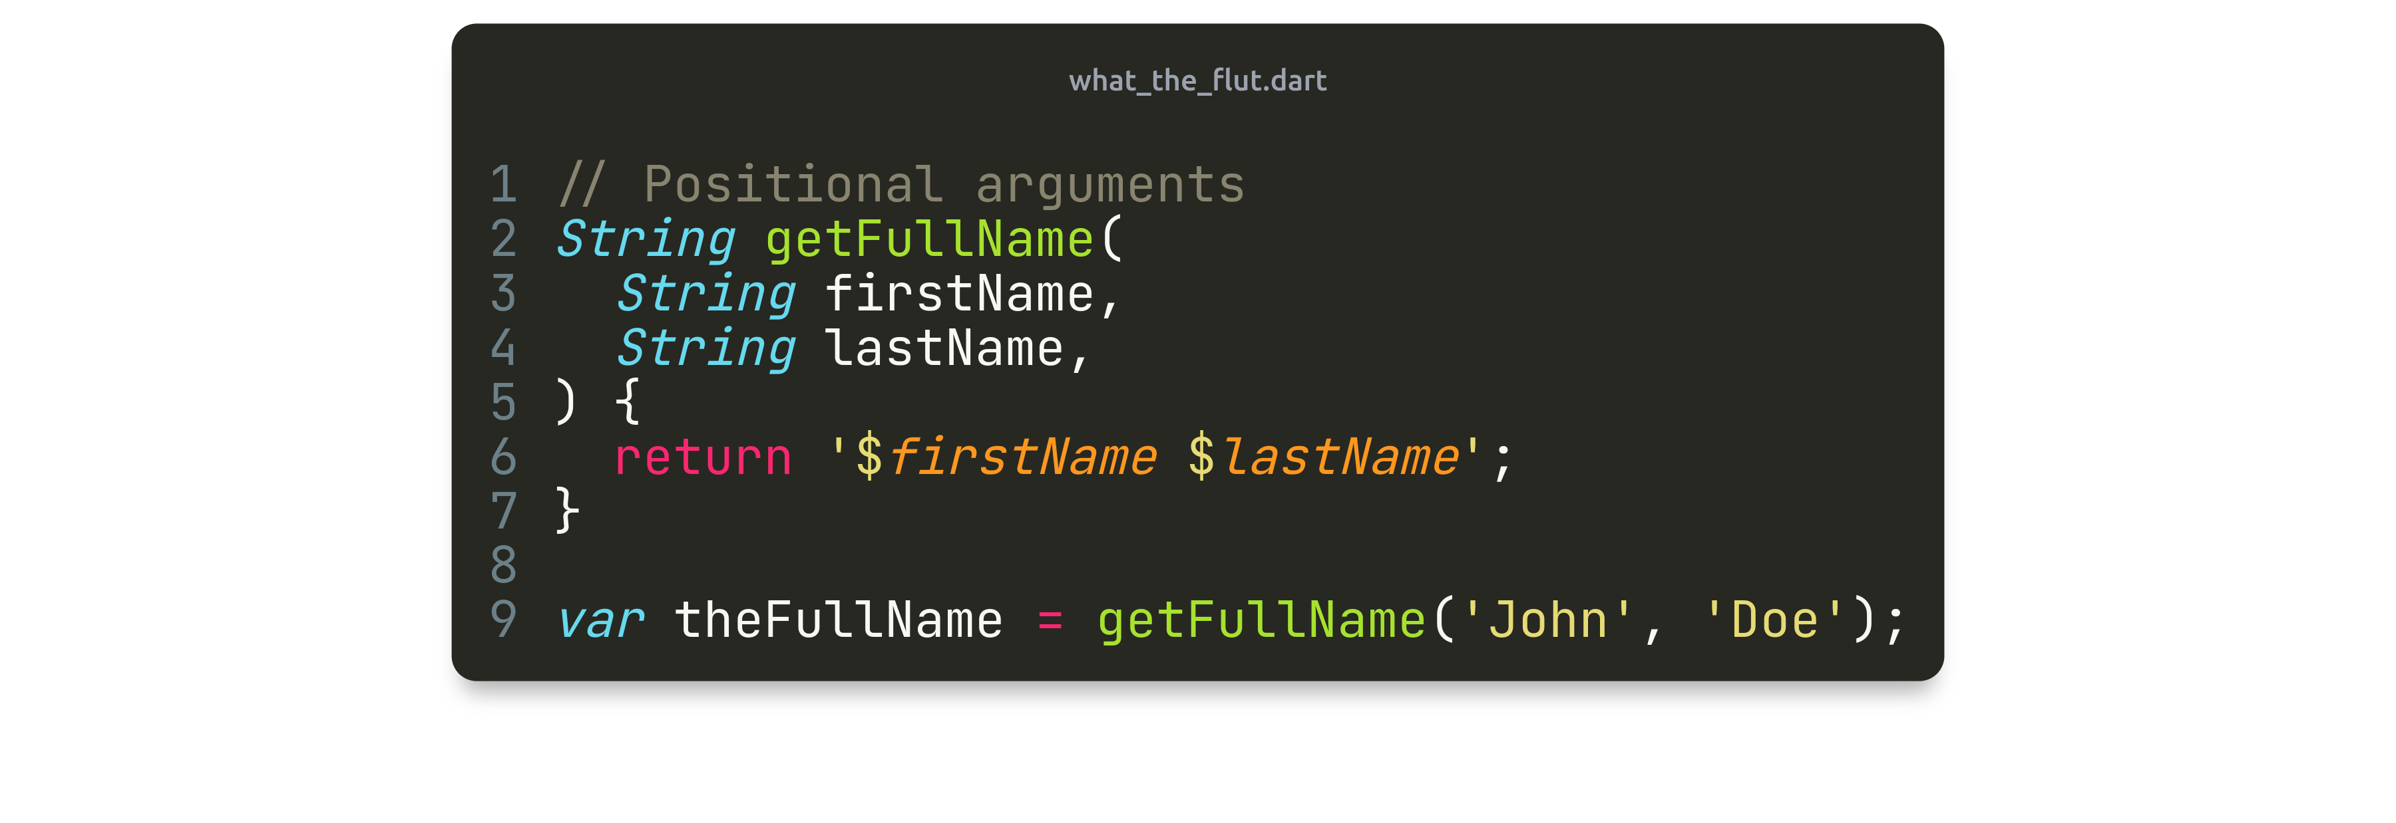
Key concepts of the Dart syntax

Slide 11
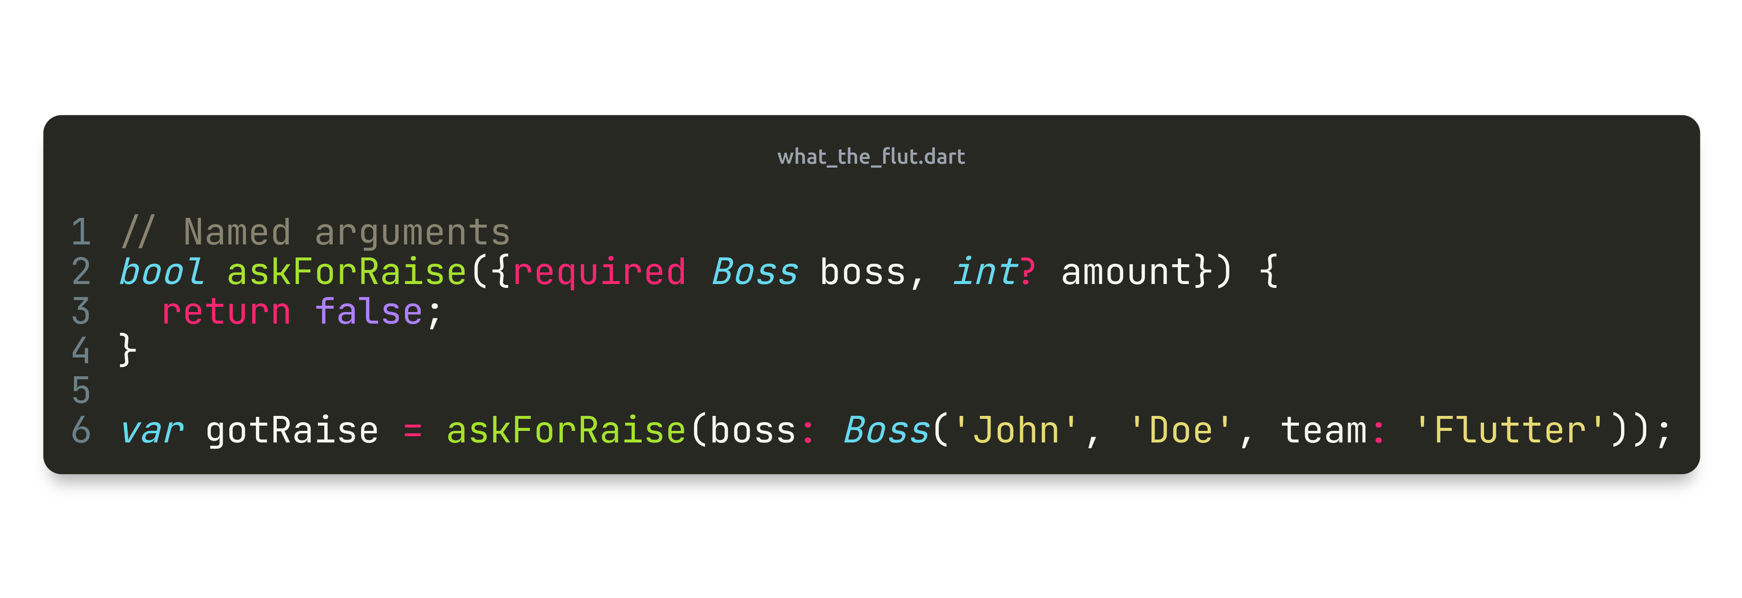
Key concepts of the Dart syntax

Slide 12
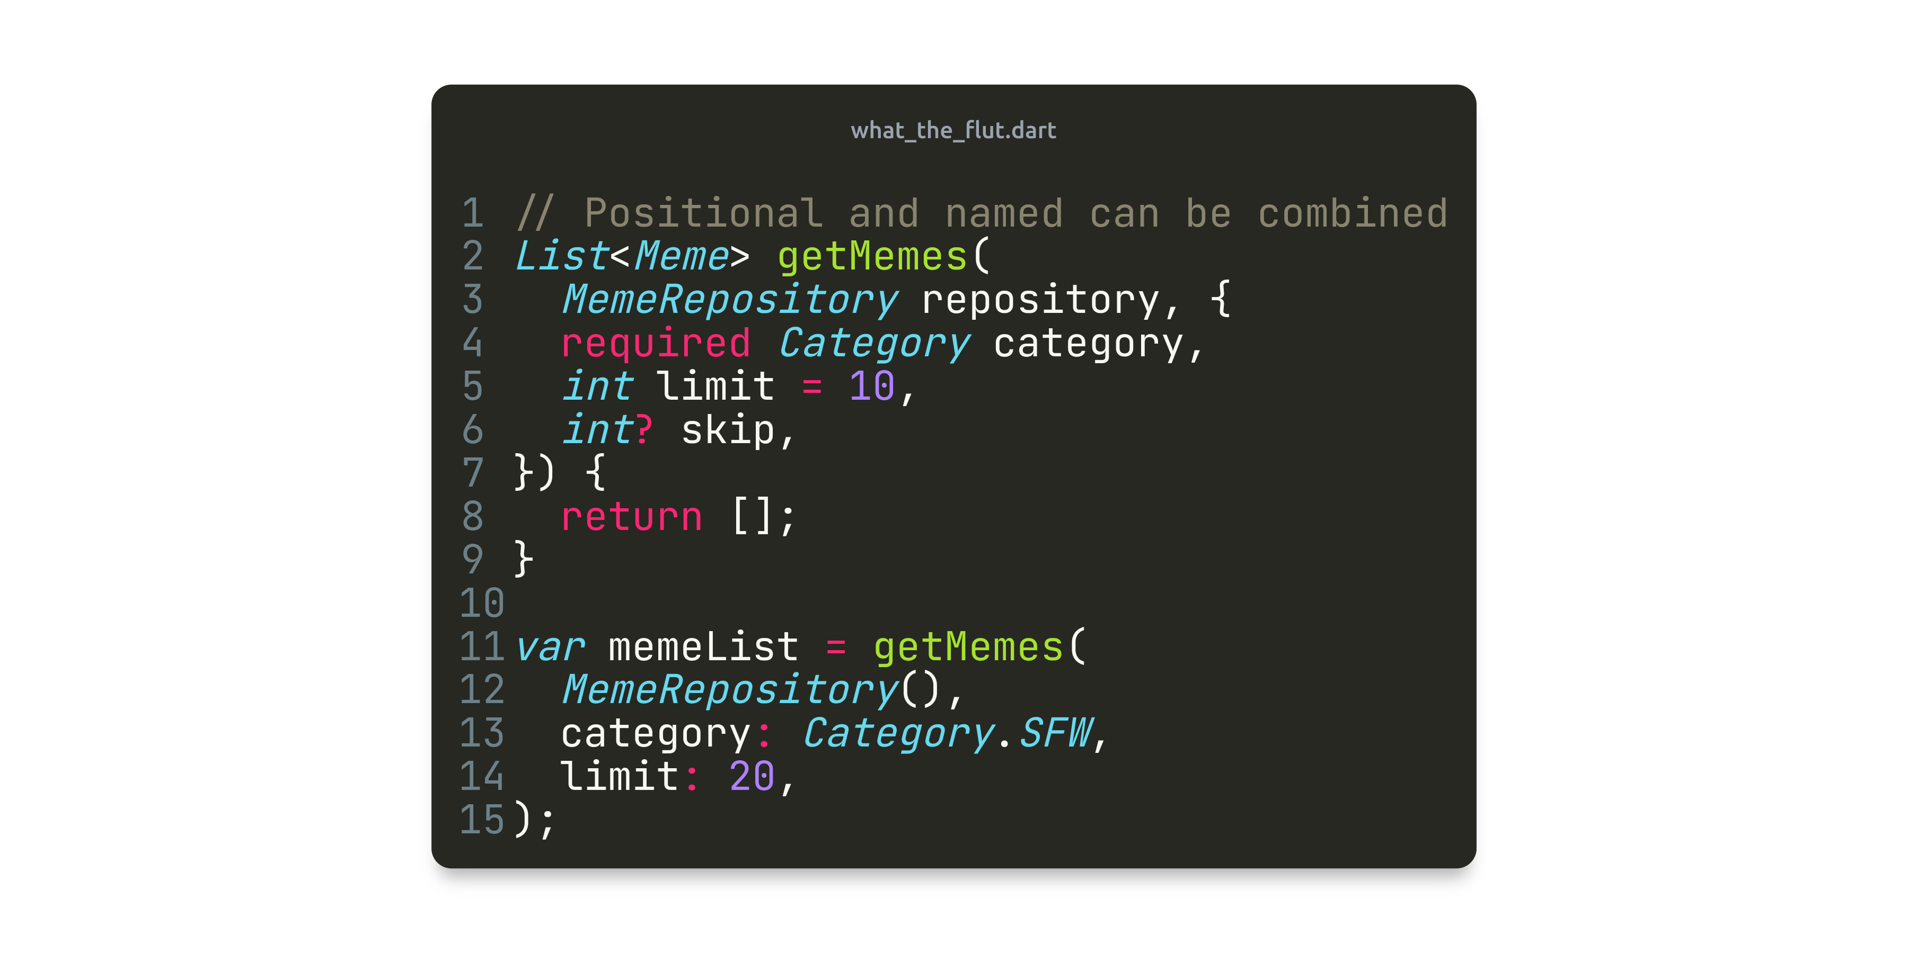
Key concepts of the Dart syntax

Slide 13
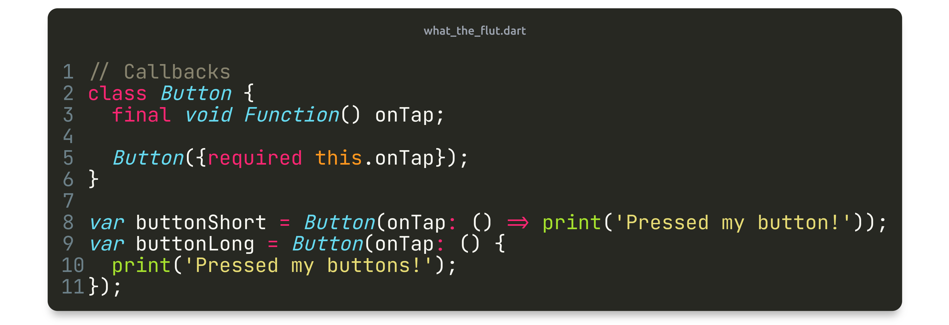
Key concepts of the Dart syntax

Slide 14
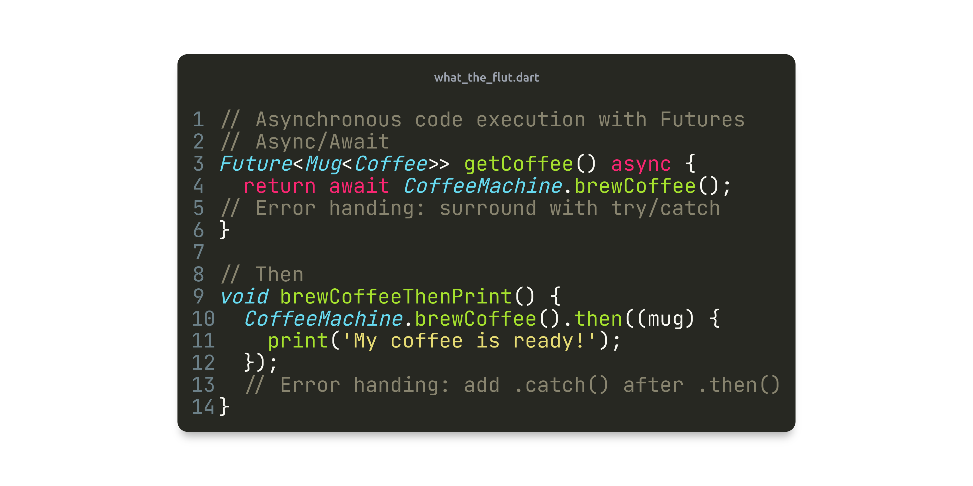
Key concepts of the Dart syntax

Slide 15
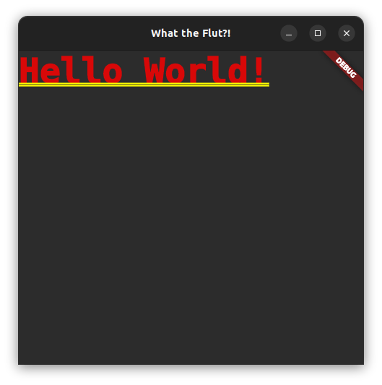
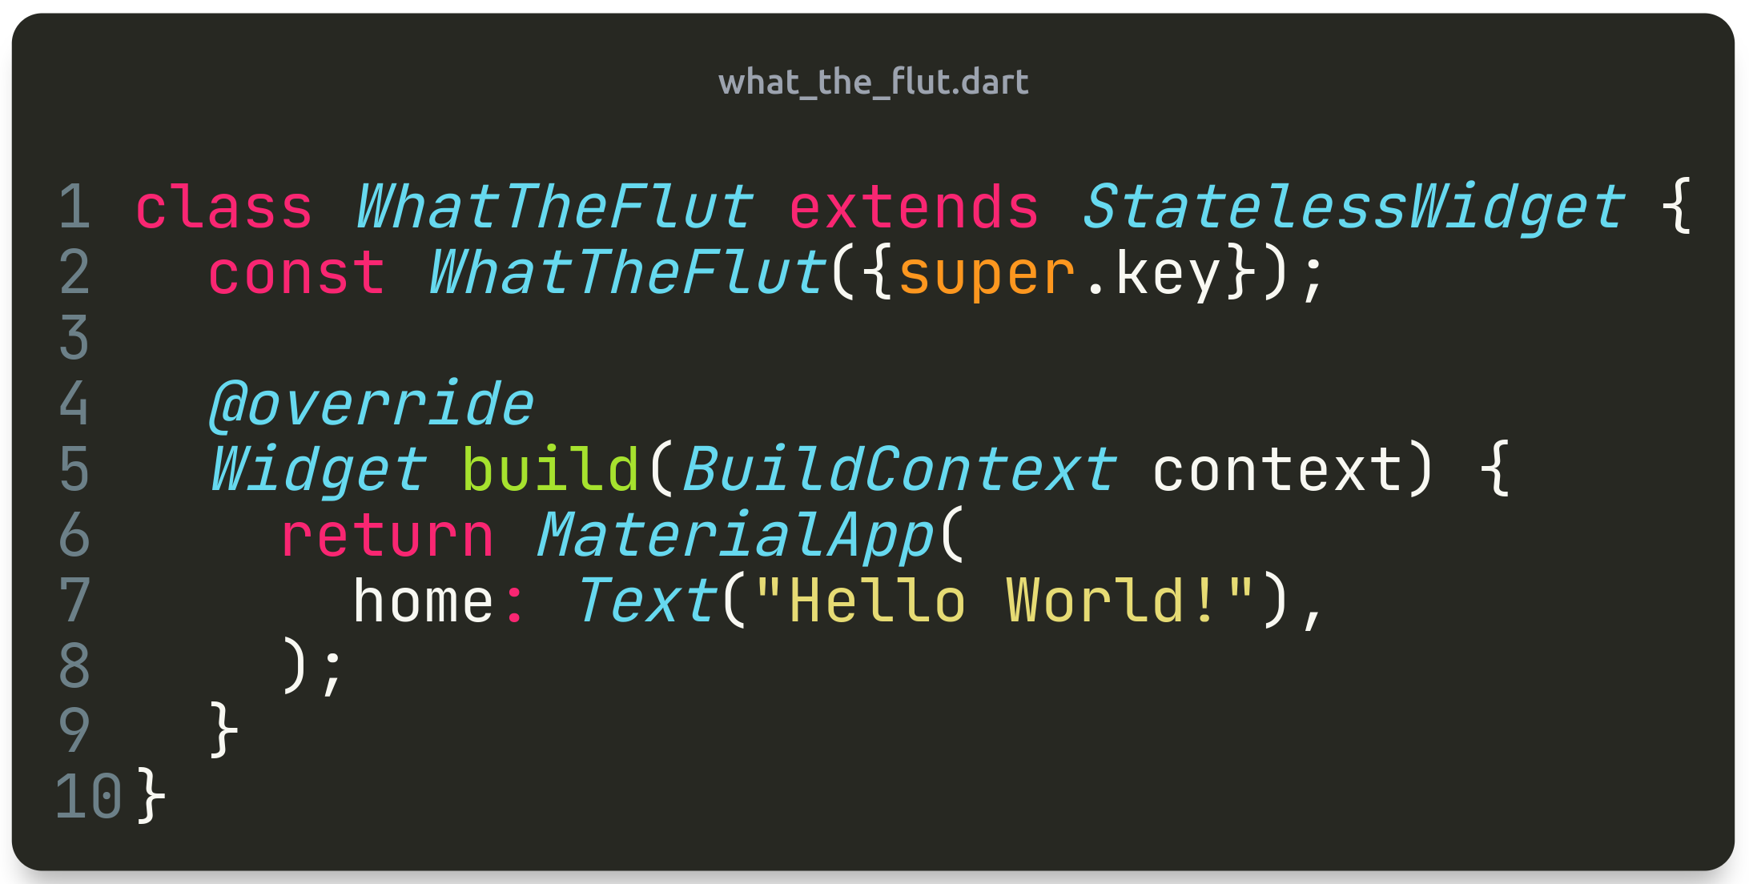
How to Flutter
Widgets in widgets in widgets in widgets in widgets in widgets in widgets in widgets in widgets in widgets

Slide 16
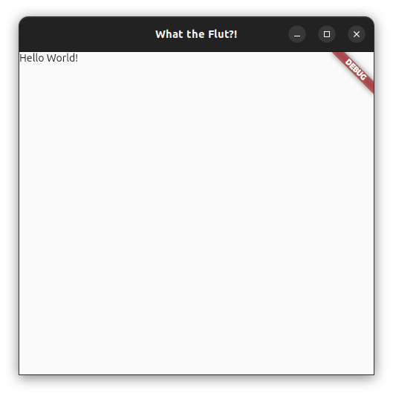
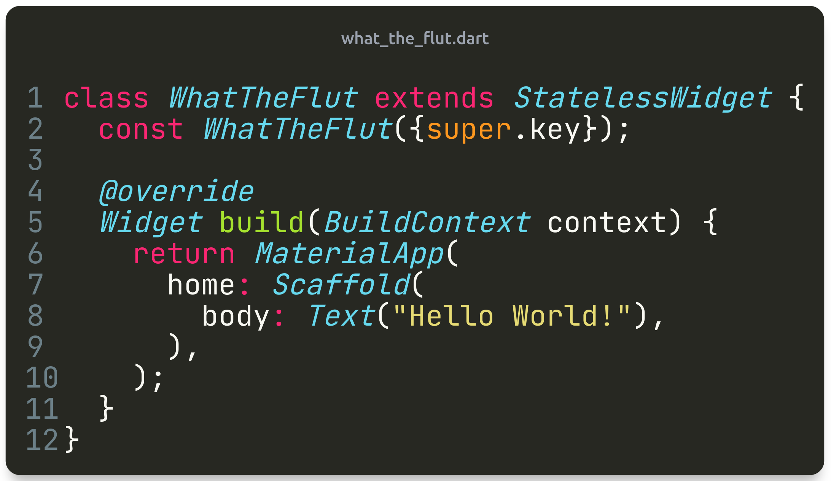
How to Flutter
Widgets in widgets in widgets in widgets in widgets in widgets in widgets in widgets in widgets in widgets

Slide 17
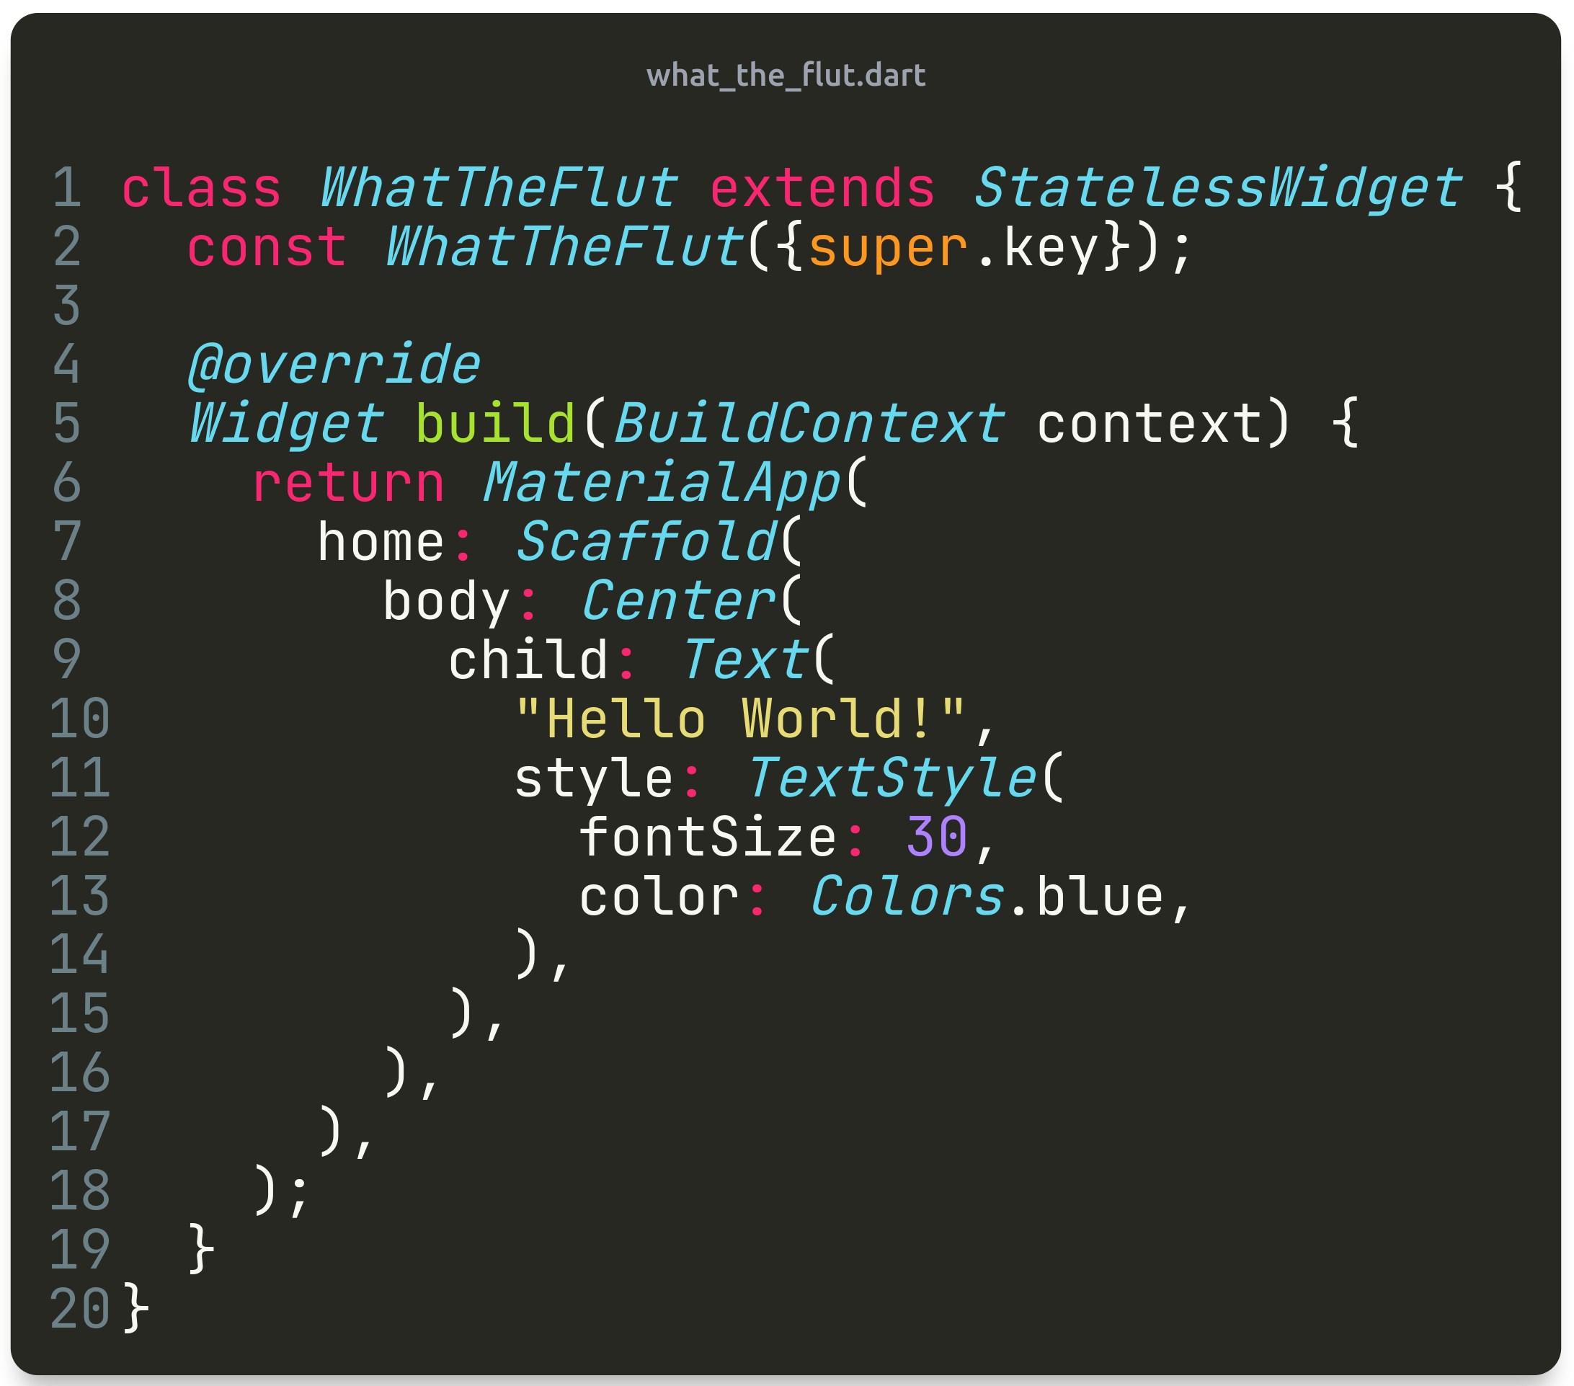
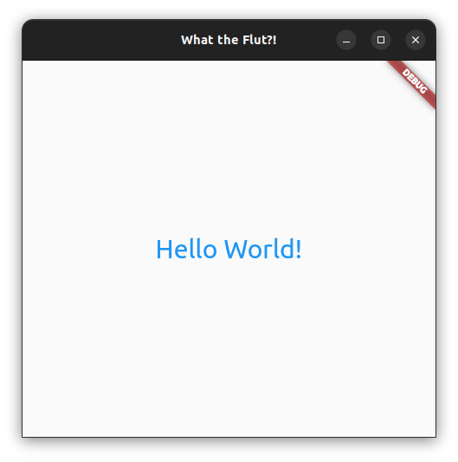
How to Flutter
Widgets in widgets in widgets in widgets in widgets in widgets in widgets in widgets in widgets in widgets

Slide 18
Time to code
Disclaimer: I stop being able to type when people are watching

Slide 19
Robbin Schepers
Robbin.Schepers@Ordina.nl
Online: @Roboroads

